Slide 1
DIGITAL COMMUNICATION
Group Members:
Tran Thien Phuc 21207077
Pham Hoai An 21207120
Huynh Thi Ngoc Phuc 21207195
Do Minh Chuong 21207126

Slide 2
Table of contents
01
02
03
04
Project 1
Project 2
A-Law and mu-Law Companding
Optimum receiver for binary data transmission
Project 3
Project 4
Basic Digital Passband Modulation
Low-Density Parity Check Code
2/32

Slide 3
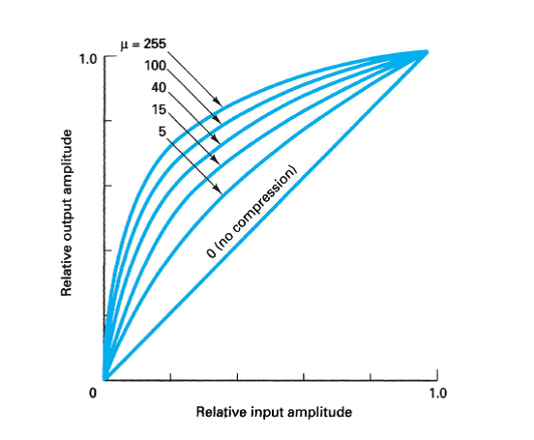
A-Law and mu-Law Companding
Project 01
3/32

Slide 4
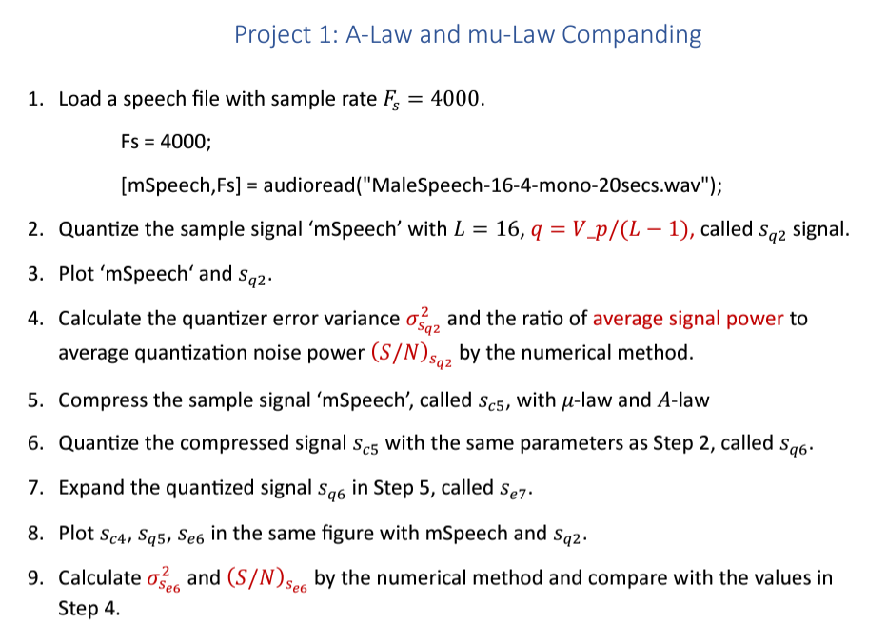
4/32

Slide 5
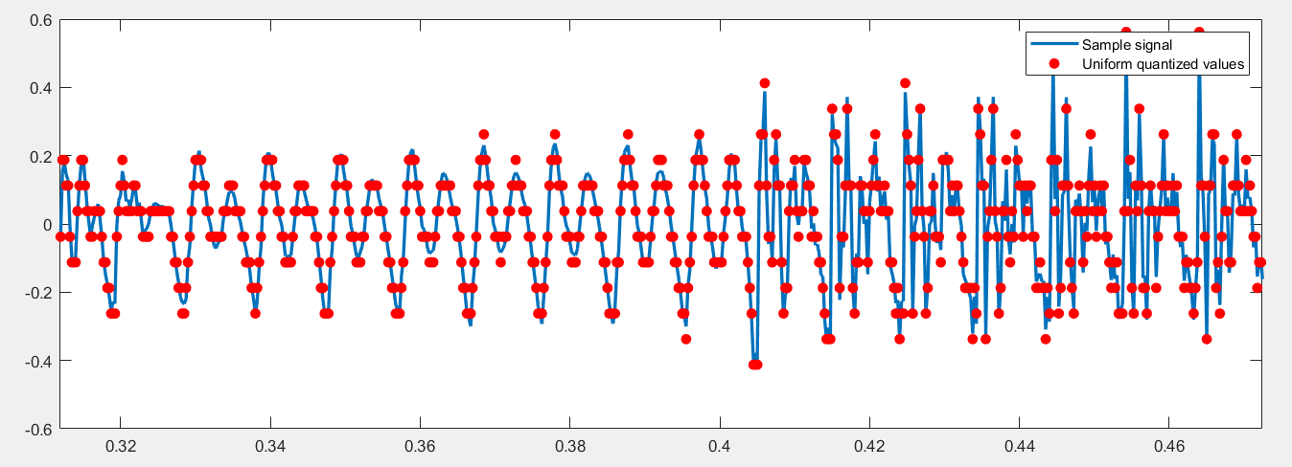
𝐿 = 16, 𝑉𝑝=0.5625, 𝑞 = 𝑉𝑝𝑝/(𝐿 − 1), called 𝑠𝑞2 signal. 𝑞 = 𝑉𝑝𝑝/(𝐿 − 1) = 2*0.5625 / (16 - 1) = 0.075
Project 1: A-Law and mu-Law Companding
I. Quantize the sample signal ‘mSpeech’
5/32

Slide 6
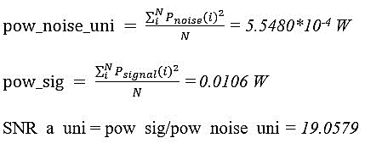
Project 1: A-Law and mu-Law Companding
II. Calculate the quantizer
4. Error variance (𝜎_{S𝑞2})² and the ratio of average signal power to average quantization noise power (𝑆/𝑁)_{S𝑞2} by the numerical method.
6/32

Slide 7
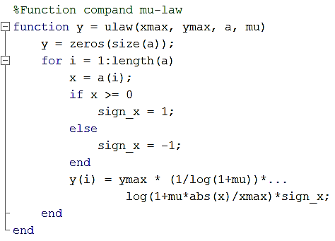
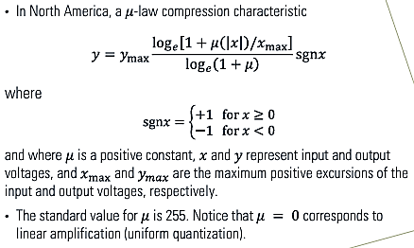
Project 1: A-Law and mu-Law Companding
5. Compress the sample signal ‘mSpeech’, called 𝑠_{𝑐5}, with 𝜇-law and 𝐴-law
With 𝜇-law
s_c_5 = ulaw(x_max, y_max, mSpeech(1:length(t)), mu);
plot(t, s_c_5, 'r--');
7/32

Slide 8
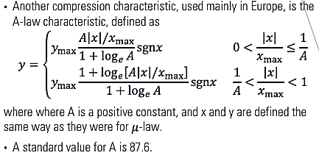
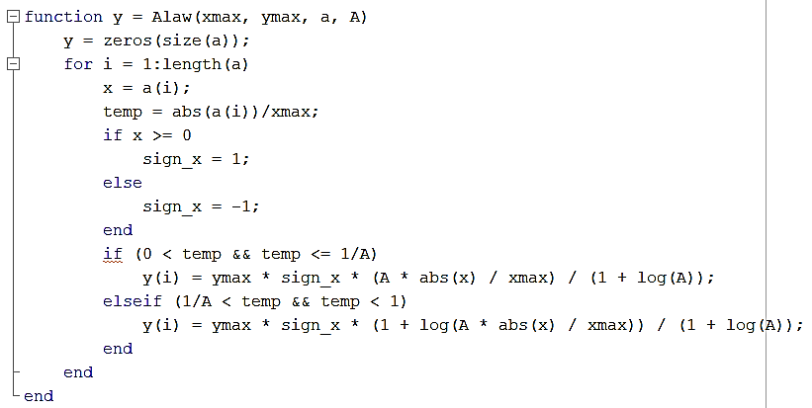
Project 1: A-Law and mu-Law Companding
With A-law
s_c_5 = Alaw(x_max, y_max, mSpeech(1:length(t)), A);
plot(t, s_c_5, 'r--');
8/32

Slide 9
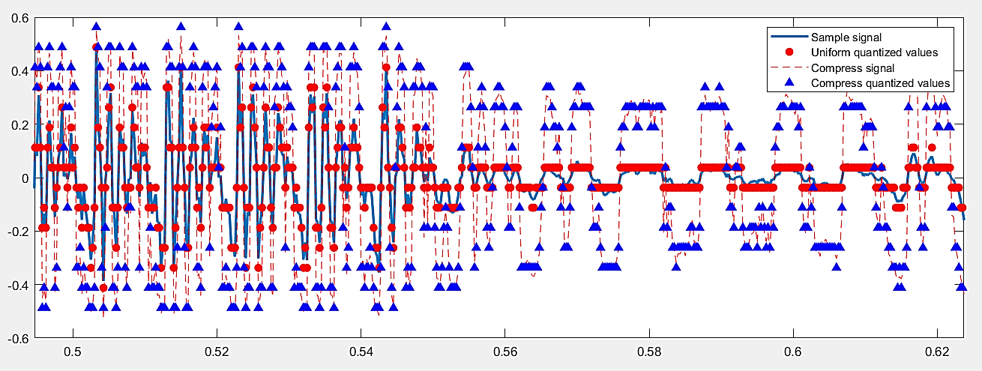
Project 1: A-Law and mu-Law Companding
6. Quantize the compressed signal 𝑠_{𝑐5} with the same parameters as Step 2, called 𝑠_{𝑞6}
s_q_6 = quan_uni(s_c_5, q);
plot(t, s_q_6, 'b^', 'MarkerSize', 6, 'MarkerEdgeColor', 'b', 'MarkerFaceColor', 'b');
9/32

Slide 10
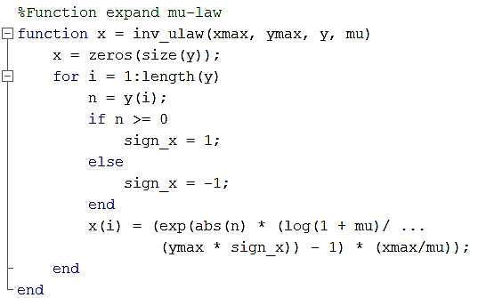
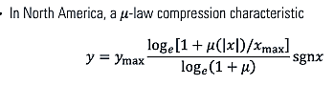
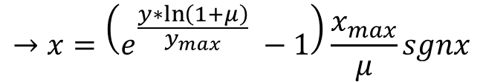
Project 1: A-Law and mu-Law Companding
7. Expand the quantized signal 𝑠_{𝑞6} in Step 5, called 𝑠_{𝑒7}
With 𝜇-law
$$→x=\left(e^{\frac{y∗\ln\left(1+μ\right)}{y_{max}}} −1\right)\frac{x_{max}}{μ}sgnx$$
s_e_7 = inv_ulaw(x_max, y_max, s_q_6, mu); %mu-Law
10/32

Slide 11
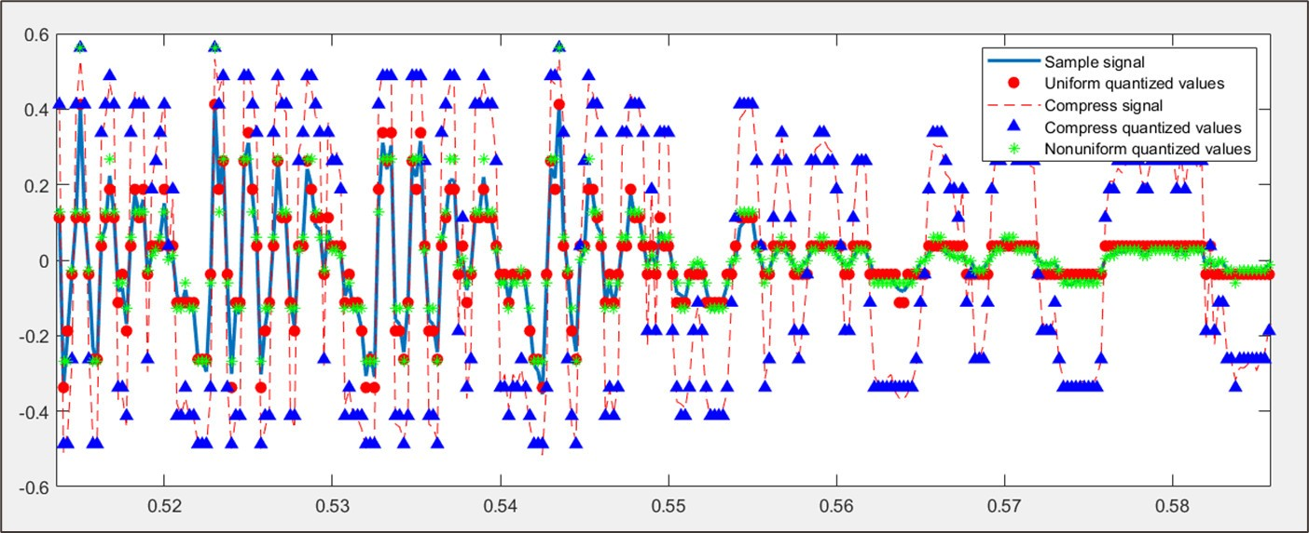
Project 1: A-Law and mu-Law Companding
8. Plot 𝑠_{𝑐4}, 𝑠_{𝑞5}, 𝑠_{𝑒6} in the same figure with mSpeech and 𝑠_{𝑞2}
11/32

Slide 12
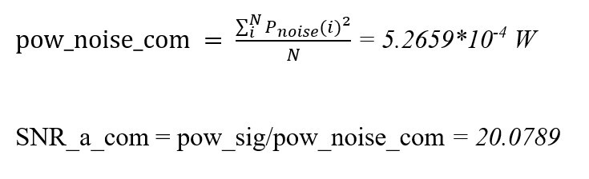
9. Calculate (𝜎_{S𝑒6})² and (𝑆/𝑁)_{S𝑒6} by the numerical method and compare with the values in Step 4.
e_com = mSpeech(1:length(t)) - s_e_7;
pow_noise_com = 0;
for i = 1:length(t)
pow_noise_com = pow_noise_com + e_com(i)^2;
end
pow_noise_com = pow_noise_com / length(t);
SNR_a_com = pow_sig / pow_noise_com;
>> SNR_a_uni = 19.0579 < SNR_a_com = 20.0789
12/32

Slide 13
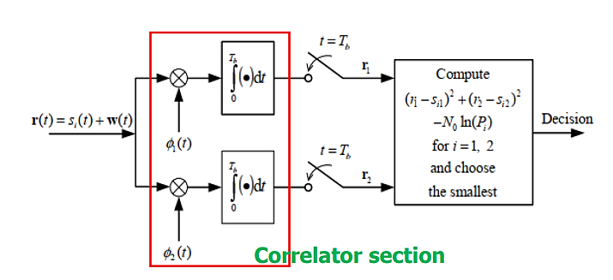
Project 02
Optimum receiver for binary data transmission
13/32

Slide 14
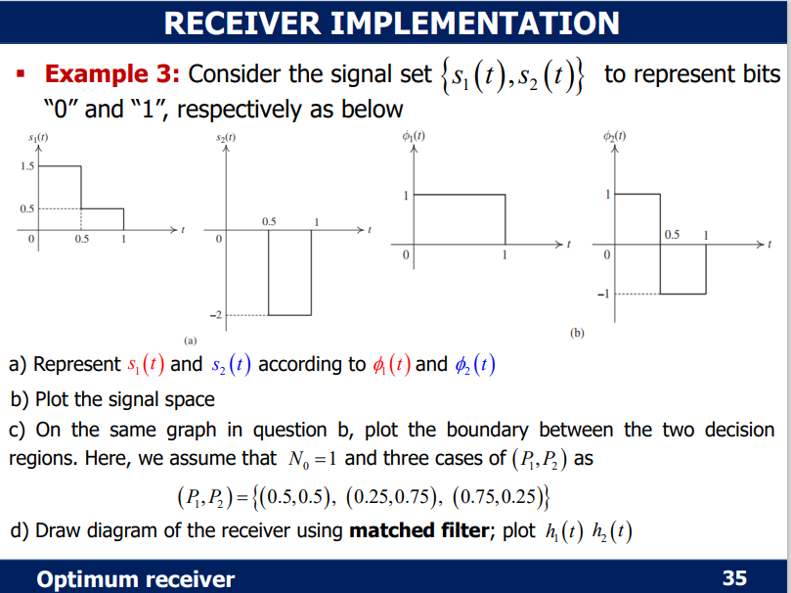
CHAPTER 3 : Optimum Receiver for binary data transmission
Problem 1 : Using the hyper thesis in Example 3, complete the following code to present 10 bits of the signal, which is transmitted with P1 = P2= 0.5.
14/32

Slide 15
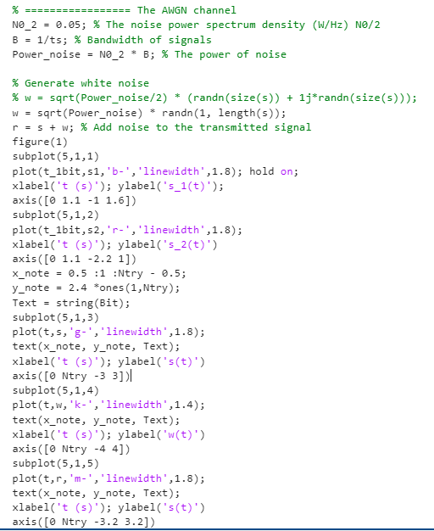
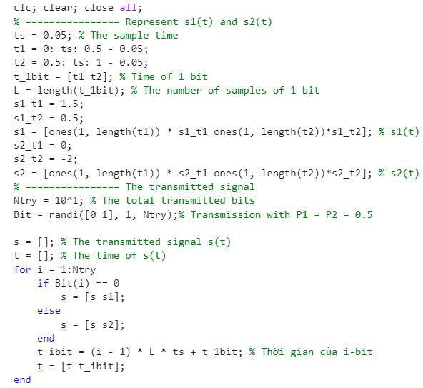
Source Code
15/32

Slide 16
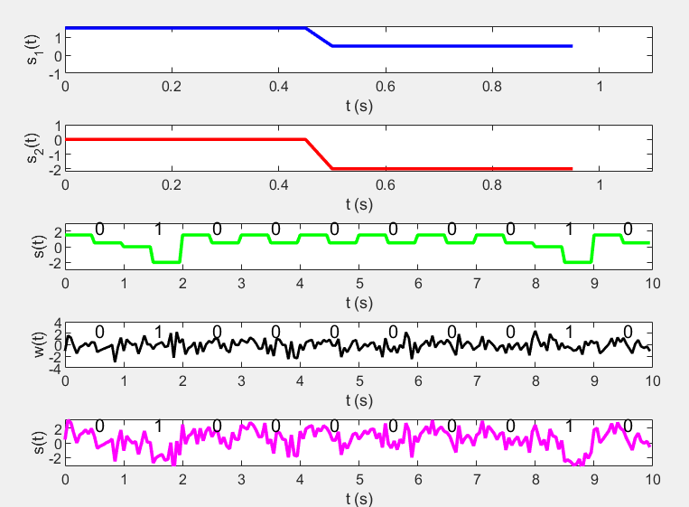
Conclusion
16/32

Slide 17
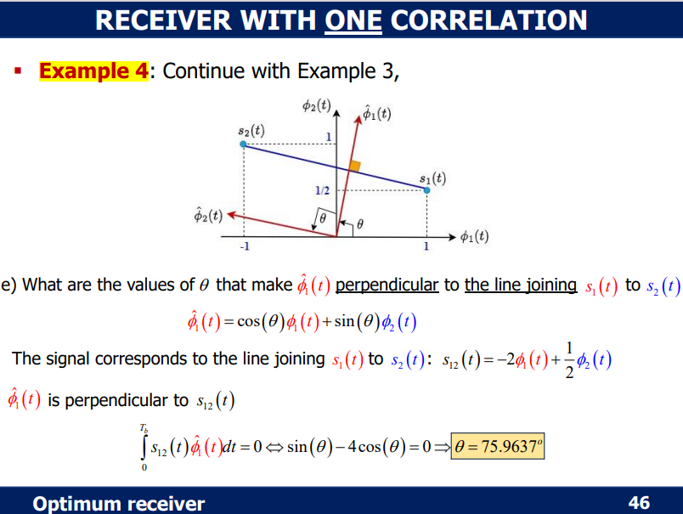
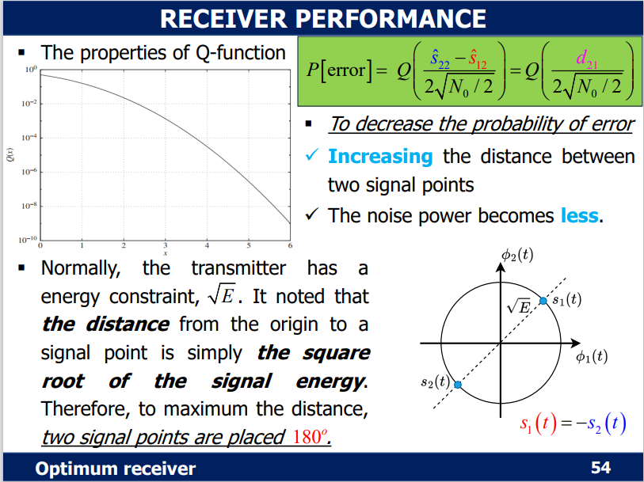
CHAPTER 3 : Optimum Receiver for binary data transmission
Problem 2 : Based on the receiver implementation in Example 4, complete the following code to evaluate the system performance via the bit error probability.
17/32

Slide 18
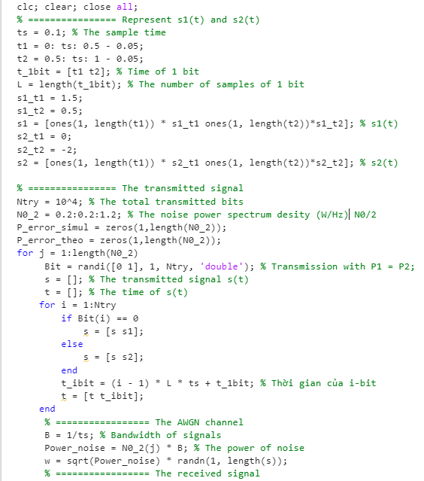
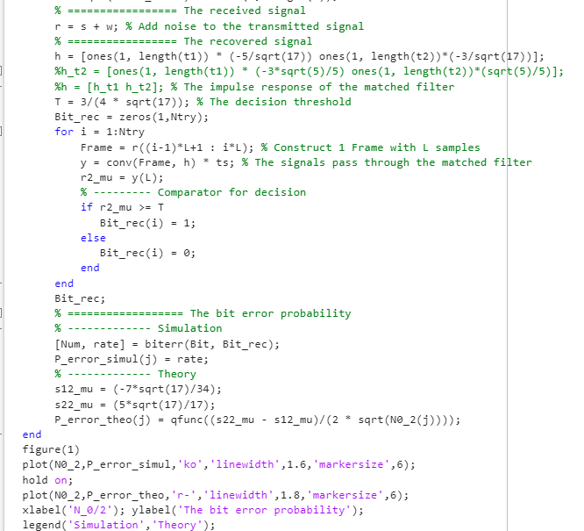
Source Code
18/32

Slide 19
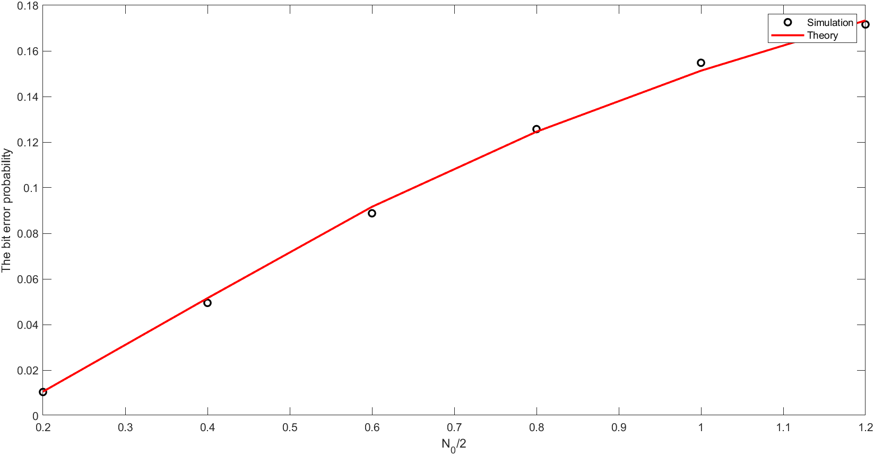
Conclusion
19/32

Slide 20
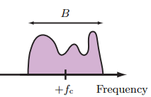
Basic Passband Modulation
Project 03
20/32

Slide 21
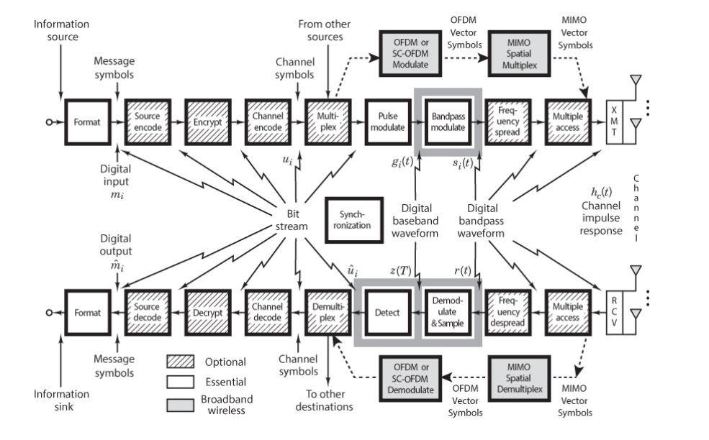
Introduction
In baseband transmission, the transmitted signal power lies at low frequencies, typically around zero. It is desirable in many digital
communication systems for the transmitted signal to lie in a high frequency band.
21/32

Slide 22
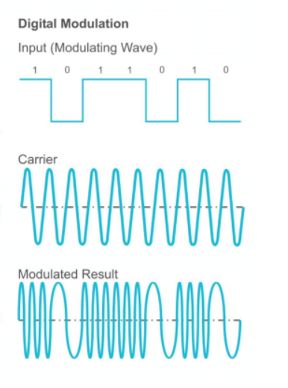
Introduction
The digital information is encoded by variation of the parameters of asinusoidal signal, called the carrier signal. The carrier frequency is much higher than the highest frequency of the modulating signals.
Digital passband modulation is based on variation of the amplitude, phase, or frequency of sinusoidal carrier, or some combination of these parameters.
22/32

Slide 23
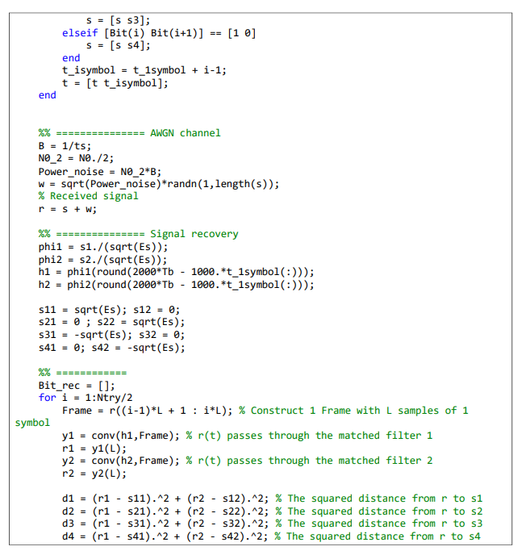
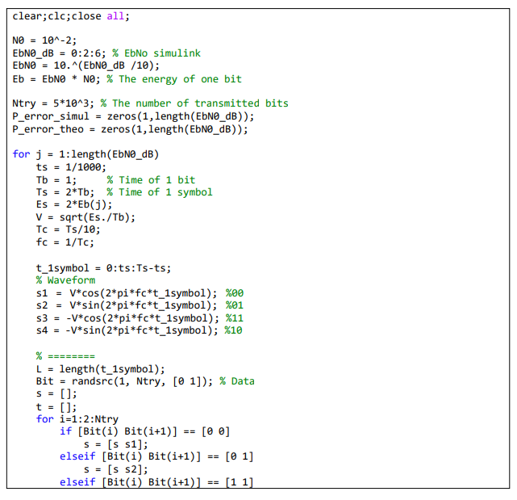
The error performance of the passband modulation QPSK
Matlab source
23/32

Slide 24
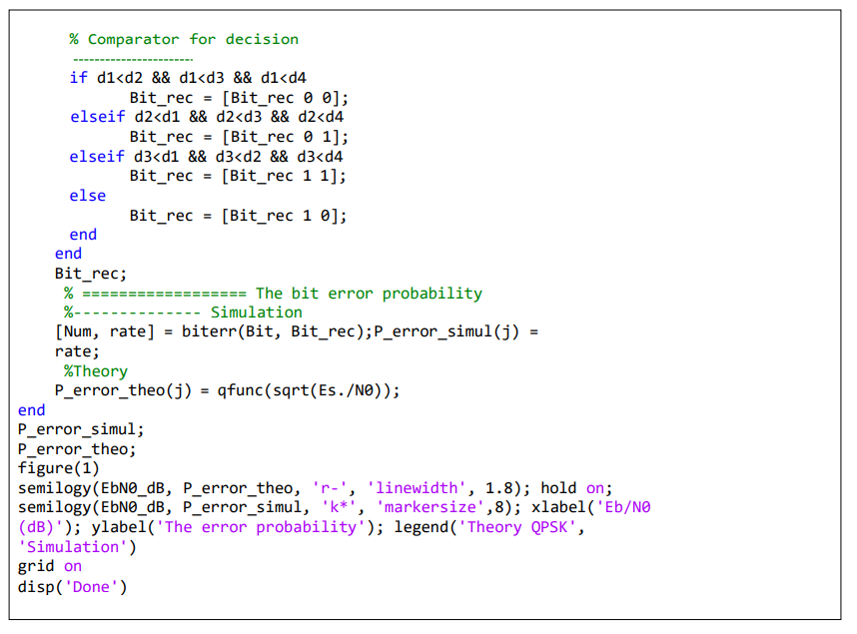
The error performance of the passband modulation QPSK
Matlab source
24/32

Slide 25
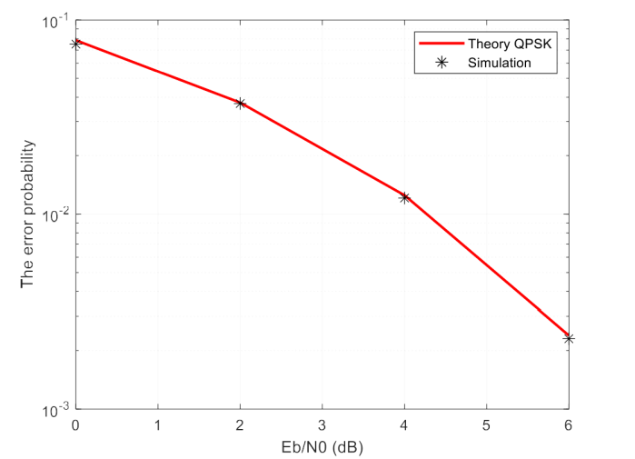
The simulation result
25/32

Slide 26
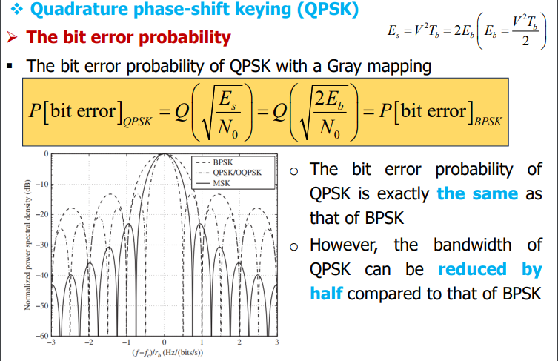
Conclusion
26/32

Slide 27
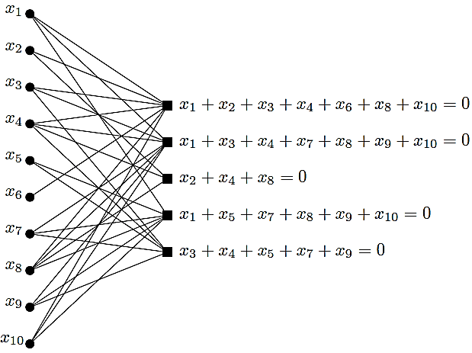
Project 4
Low-Density Parity-Check Codes
27/32

Slide 28
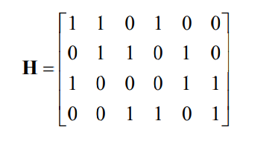
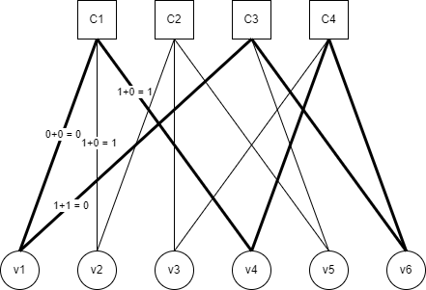
The Tanner Graph
A Tanner Graph is a bipartite graph which represents the parity check matrix of an error correcting code.
The Parity Check Matrix given below:
Check nodes
Bit nodes
From the Parity Check Matrix H: H[1,1] H[1,2], H[1,4] = 1
So, first Check node is connected to 1, 2, 4th Bit note.
Rest of the nodes are connected in similar way.
28/32

Slide 29
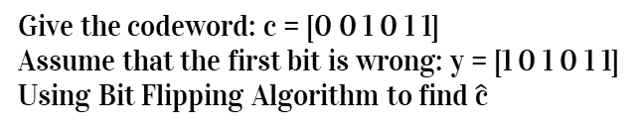
Bit Flipping Algorithm
The bit-flipping algorithm is a hard-decision message-passing algorithm for LDPC codes. A binary (hard) decision about each received bit is made by the detector and this is passed to the decoder.
Give the codeword: c = [0 0 1 0 1 1]
Assume that the first bit is wrong: y = [1 0 1 0 1 1]
Using Bit Flipping Algorithm to find $\hat{\text{c}}$
The 1st and 3rd Check node give message to
The first check node gives message to v1, v2 and v4, so:
v1 = v2 + v4 = 0 + 0 = 0;
v2 = v1 + v4 = 1 + 0 = 1;
v4 = v1 + v2 = 1 + 0 = 1;
The third check node give message to v1, v5 and v6, so:
v1 = v5 + v6 = 1 + 1 = 0;
v5 = v1 + v6 = 1 + 1 = 0;
v6 = v1 + v5 = 1 + 1 = 0;
Because, A1[1; 3] = [0; 0] so 1st bit is flipped
A1 is a set of message from check nodes.
29/32

Slide 30
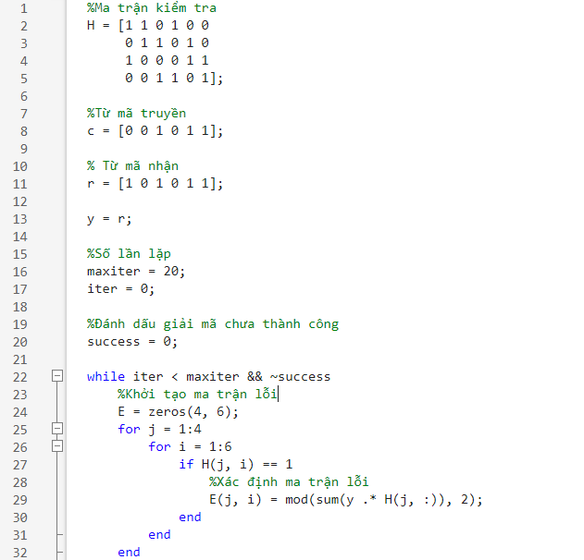
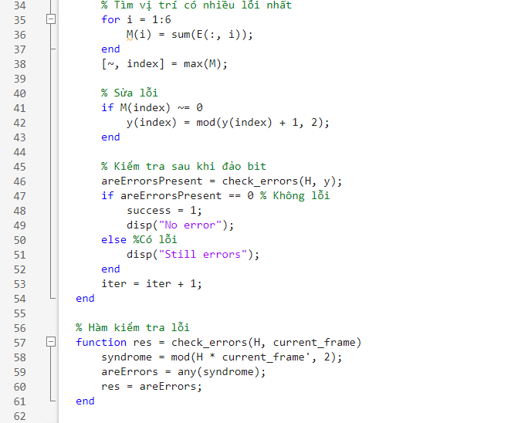
Code
30/32

Slide 31
Source code Algorithm
while iter < maxiter && ~success
%Khởi tạo ma trận lỗi
E = zeros(4, 6);
for j = 1:4
for i = 1:6
if H(j, i) == 1
%Xác định ma trận lỗi
E(j, i) = mod(sum(y .* H(j, :)), 2);
end
end
end
% Tìm vị trí có nhiều lỗi nhất
for i = 1:6
M(i) = sum(E(:, i));
end
[~, index] = max(M);
% Sửa lỗi
if M(index) ~= 0
y(index) = mod(y(index) + 1, 2);
end
% Kiểm tra sau khi đảo bit
areErrorsPresent = check_errors(H, y);
if areErrorsPresent == 0 % Không lỗi
success = 1;
disp("No error");
else %Có lỗi
disp("Still errors");
end
iter = iter + 1;
end
Main loop, break when reach to maxiter or success.
Create Error Matrix E
If H(j, i) = 1, calculate sum of product of y and row j of H
E(j, i) equal to modulo – 2 of SOP
Find the column has most error and save in variable “index”
Use modulo – 2 of y(index) to flipped this [index] bit of y
Use “check_errors” function to check error
If no error then success = 1 and break this loop, else increase iter and back to the first step.
%Ma trận kiểm tra
H = [1 1 0 1 0 0
0 1 1 0 1 0
1 0 0 0 1 1
0 0 1 1 0 1];
%Từ mã truyền
c = [0 0 1 0 1 1];
% Từ mã nhận
r = [1 0 1 0 1 1];
y = r;
%Số lần lặp
maxiter = 20;
iter = 0;
%Đánh dấu giải mã chưa thành công
success = 0;
Init parameters
Parity Check Matrix
Transmit Codeword
Receive Codeword
Set y equal to Receive Codeword
Set max iteration
Set success flag
31/32

Slide 32
Thank You For Listening

